Slide 1

Chapter 5
Dynamic Testing: White Box Testing Techniques
Objectives
White box testing needs the full understanding of the logic/structure of the program.
Test case designing using white box testing techniques
Basis Path testing method
Building a Path testing tool using graph matrices
Loop testing
Data Flow testing method
Mutation testing method
© Oxford University Press 2011. All rights reserved.

Slide 2
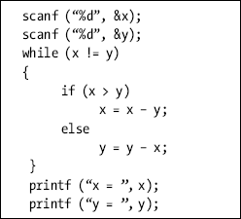
Evolution of Software Testing
Logic Coverage Criteria
Statement Coverage
Test case 1: x = y = n, where n is any number
Test case 2: x = n, y = n’, where n and n’ are different numbers.
Test case 3: x > y
Test case 4: x < y
© Oxford University Press 2011. All rights reserved.

Slide 3
Evolution of Software Testing
Logic Coverage Criteria
Decision or Branch Coverage
Test case 1: x = y
Test case 2: x != y
Test case 3: x < y
Test case 4: x > y
Condition Coverage
while ((I <= 5) && (J < COUNT))
Test case 1: I <= 5, J < COUNT
Test case 2: I > 5, J > COUNT
© Oxford University Press 2011. All rights reserved.

Slide 4
Logic Coverage Criteria
Decision / Condition Coverage
If (A && B)
Test Case 1: A is True, B is False.
Test Case 2: A is False, B is True.
Multiple Condition Coverage
Test Case 1: A = TRUE, B = TRUE
Test Case 2: A = TRUE, B = FALSE
Test Case 3: A = FALSE, B = TRUE
Test Case 4: A = FALSE, B = FALSE
© Oxford University Press 2011. All rights reserved.

Slide 5
Basis Path Testing
Path Testing is based on control structure of the program for which flow graph is prepared.
requires complete knowledge of the program’s structure.
closer to the developer and used by him to test his module.
The effectiveness of path testing is reduced with the increase in size of software under test.
Choose enough paths in a program such that maximum logic coverage is achieved.
© Oxford University Press 2011. All rights reserved.

Slide 6
Control Flow Graph
Node
Edges or Links
Decision Node
Junction Node
Regions
© Oxford University Press 2011. All rights reserved.

Slide 7
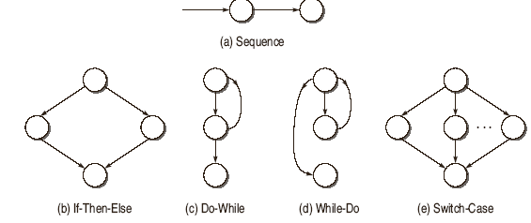
Control Flow Graph
    Flow Graph Notations for Different Programming Constructs
© Oxford University Press 2011. All rights reserved.

Slide 8
Software Testing Myths
Path Testing Terminology
Path
Segment
Path Segment
Length of a Path
Independent Path
© Oxford University Press 2011. All rights reserved.

Slide 9
Path Testing Terminology
Cyclomatic Complexity
V(G) = e-n+2P
V(G) = d + P
V(G) = number of Regions in the graph
© Oxford University Press 2011. All rights reserved.

Slide 10
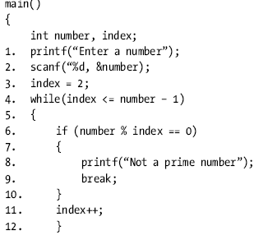

Example
© Oxford University Press 2011. All rights reserved.

Slide 11
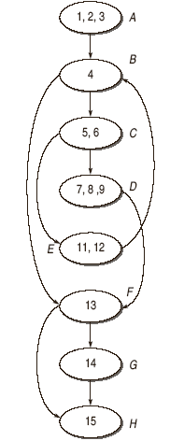
Example
© Oxford University Press 2011. All rights reserved.

Slide 12
Example
Cyclomatic Complexity
  V(G) = e – n + 2 * P
= 10 – 8 +2
= 4
  V(G) = Number of predicate nodes + 1
= 3 (Nodes B,C and F) + 1
= 4
  V(G) = No. of Regions
= 4 (R1, R2, R3, R4)
© Oxford University Press 2011. All rights reserved.

Slide 13
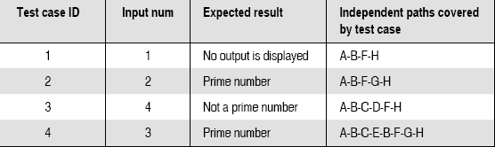
Example
Independent Paths
A-B-F-H
A-B-F-G-H
A-B-C-E-B-F-G-H
A-B-C-D-F-H
© Oxford University Press 2011. All rights reserved.

Slide 14
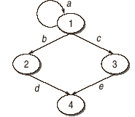
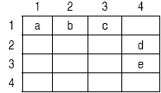
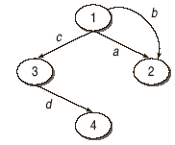
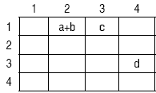
Graph Matrices
© Oxford University Press 2011. All rights reserved.

Slide 15
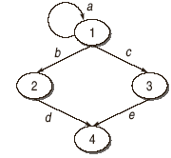
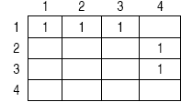
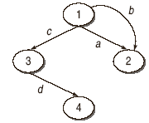
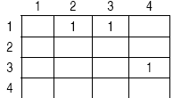
Graph Matrices
Connection Matrix
© Oxford University Press 2011. All rights reserved.

Slide 16
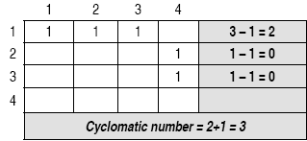
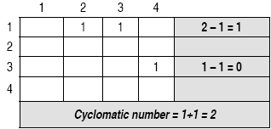
Graph Matrices
Use of Connection Matrix in finding Cyclomatic Complexity Number
© Oxford University Press 2011. All rights reserved.

Slide 17
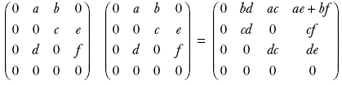
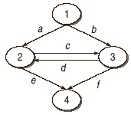
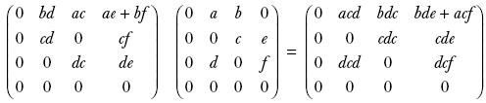
Graph Matrices
Use of Graph Matrix for Finding the Set of all Paths
Consider the following graph. Derive its graph matrix and find 2-link and 3-link set of paths.
© Oxford University Press 2011. All rights reserved.

Slide 18
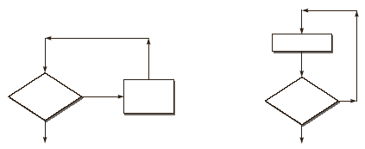
Loop Testing
Simple Loops
Check whether the loop control variable is negative.
Write one test case that executes the statements inside the loop.
Write test cases for a typical number of iterations through the loop.
Write test cases for checking the boundary values of maximum and minimum number of iterations defined (say min and max) in the loop. It means we should test for the min, min+1, min-1, max-1, max and max+1 number of iterations through the loop.
© Oxford University Press 2011. All rights reserved.

Slide 19
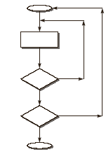
Loop Testing
Nested Loops
Number of possible test cases grow geometrically. Thus the strategy is to start with the innermost loops while holding outer loops to their minimum values. Continue this outward in this manner until all loops have been covered
© Oxford University Press 2011. All rights reserved.

Slide 20
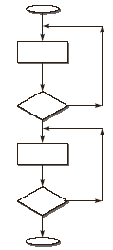
Loop Testing
Concatenated Loops
loops are concatenated if it is possible to reach one after exiting the other while still on a path from entry to exit.
© Oxford University Press 2011. All rights reserved.

Slide 21
Data Flow Testing
Detect improper use of data values due to coding errors.
Closely examines the state of the data in the control flow graph resulting in a richer test suite than the one obtained from control flow graph based path testing strategies like branch coverage, all statement coverage, etc
© Oxford University Press 2011. All rights reserved.

Slide 22
Data Flow Testing
Defined (d):
Killed / Undefined / Released (k):
Usage (u):
computational use (c-use) or predicate use (p-use).
© Oxford University Press 2011. All rights reserved.

Slide 23
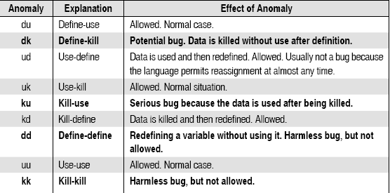
Data Flow Testing
Data-Flow Anomalies
© Oxford University Press 2011. All rights reserved.

Slide 24
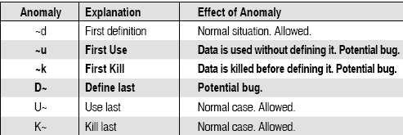
Data Flow Testing
Data-Flow Anomalies
© Oxford University Press 2011. All rights reserved.

Slide 25
Data Flow Testing
Terminology used in Data Flow Testing
Definition Node
Input statements, Assignment statements, Loop control statements, Procedure calls, etc.
Usage Node
Output statements, Assignment statements (Right), Conditional statements, Loop control statements, etc.
Loop Free Path Segment
Simple Path Segment
Definition-Use Path (du-path)
A du-path with respect to a variable v is a path between definition node and usage node of that variable. Usgae node can be p-usage or c-usgae node.
Definition-Clear path(dc-path)
A dc-path with respect to a variable v is a path between definition node and usage node such that no other node in the path is a defining node of variable v.
© Oxford University Press 2011. All rights reserved.

Slide 26
Data Flow Testing
Static Data Flow Testing
With static analysis, the source code is analyzed without executing it.
Dynamic Data-Flow Testing
All-du Paths (ADUP)
All-uses (AU)
All-p-uses / Some-c-uses (APU + C)
All-c-uses / Some-p-uses (ACU + P)
All-Predicate-Uses(APU)
All-Computational-Uses(ACU)
All-Definition (AD)
© Oxford University Press 2011. All rights reserved.

Slide 27
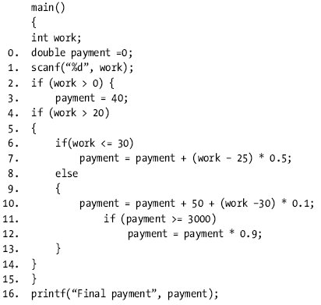
Data Flow Testing
© Oxford University Press 2011. All rights reserved.

Slide 28
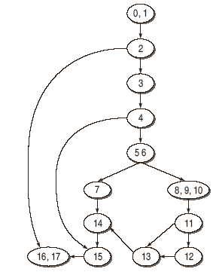
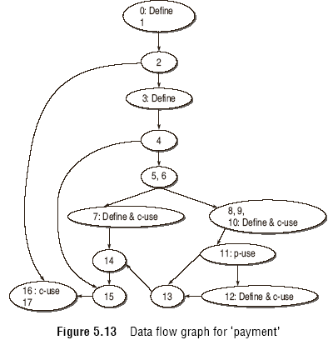
Data Flow Testing
© Oxford University Press 2011. All rights reserved.

Slide 29
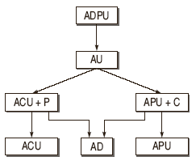
Data Flow Testing
© Oxford University Press 2011. All rights reserved.

Slide 30
Mutation Testing
Mutation testing is the process of mutating some segment of code(putting some error in the code) and then testing this mutated code with some test data. If the test data is able to detect the mutations in the code,
Mutation testing helps a user create test data by interacting with the user to iteratively strengthen the quality of test data. During mutation testing, faults are introduced into a program by creating many versions of the program, each of which contains one fault. Test data are used to execute these faulty programs with the goal of causing each faulty program to fail.
Faulty programs are called mutants of the original program and a mutant is said to be killed when a test case causes it to fail. When this happens, the mutant is considered dead
© Oxford University Press 2011. All rights reserved.

Slide 31
Mutation Testing
Let us take one example of C program shown below
…
If (a>b)
x = x + y;
else
x = y;
printf(“%d”,x);
….
We can consider the following mutants for above example:
M1: x = x – y;
M2: x = x / y;
M3: x = x+1;
M4: printf(“%d”,y);
© Oxford University Press 2011. All rights reserved.

Slide 32
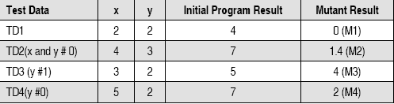
Mutation Testing
© Oxford University Press 2011. All rights reserved.

